Slide 1
Confidentiality protection and physical safeguards
Lars Vilhuber
Cornell University
Funding acknowledged under NSF-#1131848 (NCRN) and a grant from the Alfred P. Sloan Foundation

Slide 2
confidentiality and access

Slide 3

confidentiality of statistical agency data
“… when the secretary of [Commerce and Labor] directed that the census schedules of manufacturing establishments should be open to the inspection of officials belonging to another bureau within the same department […] and the director [of the Census Bureau] refused [….] because of the pledge of secrecy…”
(Walter Wilcox, 1914)

Slide 4
rich new analysis and publications
held back by concerns of citizens and businesses about privacy
1902
1942
1960
1985
today

Slide 5
Making data (more) accessible
National Data Clearinghouse
NEW?
Federal Statistical Data Centers
Commission on Evidence-based Policy

Slide 6
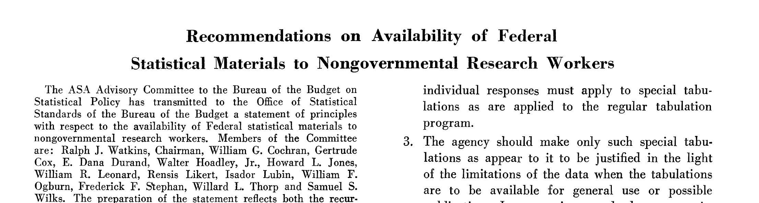
Making data (more) accessible
National Data Clearinghouse
National Data Bank
“Recommendations on Availability of Federal Statistical Materials to Nongovernmental Research Workers”
Federal Statistical Data Centers
Committee on the Preservation and Use of Economic Data
Commission on Evidence-based Policy

Slide 7
Making data (more) accessible
Making data (more) accessible
National Data Bank
1959-1965
National Data Bank (1965)
“Recommendations on Availability of Federal Statistical Materials to Nongovernmental Research Workers”
“Recommendations on Availability of Federal Statistical Materials to Nongovernmental Research Workers”
(1959)
Committee on the Preservation and Use of Economic Data
Committee on the Preservation and Use of Economic Data
(1965)
Src: Kraus (2011) https://www.census.gov/history/pdf/kraus-natdatacenter.pdf
Notes:
All of these types of questions and topics have been brought up before, more than 50 years ago.

Slide 8
driven by advances in technology…
“These improvements resulted not only in time and space savings, but cost savings as well, enabling researchers to do more detailed research and respond more quickly to pressing social issues. […] government programs designed to address social issues […] called for more information and data on those issues. […] As research needs grew and research capabilities expanded, […] increasing the demand for data.”
1960s!
Src: Kraus (2011) https://www.census.gov/history/pdf/kraus-natdatacenter.pdf
Notes:
Describing these topics, as Kraus (2011) does, could just as well apply to a text describing today’s topics

Slide 9
professional associations
At the 1959 annual meeting of the American Economic Association, members of the executive committee discussed the need for access to social and economic data for research purposes → Ruggles Report in April 1965
American Statistical Association (ASA) Advisory Committee assisted Bureau of the Budget (pre-OMB) → “Recommendations on Availability of Federal Statistical Materials to Nongovernmental Research Workers,” The American Statistician, vol. 13, no. 4 (October 1959) DOI: 10.1080/00031305.1959.10482600
Notes:
Some of the key players were the statisticians’ and economists’ professional associations

Slide 10
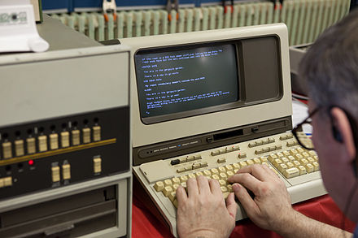

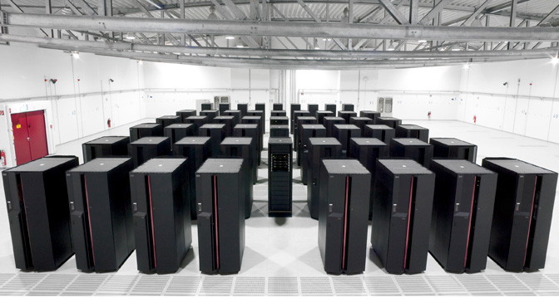
driven by advances in technology
1902
1942
1960
1985
today
Notes:
So technology is advancing, where has it gotten us today in terms of access?

Slide 11
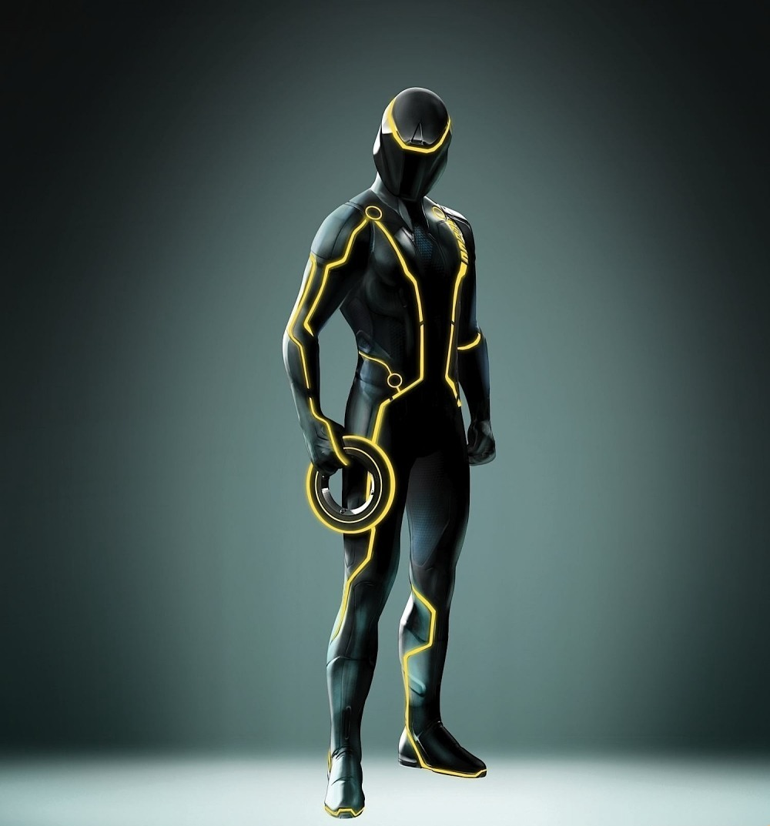


driven by advances in technology
Notes:
(joke): here is tomorrow’s technology (click) and the Census Bureau statistician’s uniform for 2030 Census (click) and the upcoming replacement for the VDI access token… (reference to Tron: Legacy movie)

Slide 12
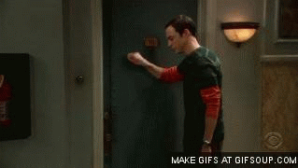
researchers knocking on the door

Slide 13
researcher access and privacy concerns
1960s in the US: proposal for “National Data Bank” with the goal of combining survey and administrative data to make available to researchers
Instead, and partially as a consequence, privacy laws were formalized in the 1970s (“Privacy Act 1974” (Public Law 93-579, 5 U.S.C. § 552a)) specifically prohibited “matching” programs, linking data from different agencies.
More recently: 2016 Australian Census elicited substantial controversy
Identifiable data with explicit goal of enabling linkages between the census and administrative data, as well as linkages across historical censuses
Notes:
Did researchers requesting access to detailed data always get the public approval they were hoping for? No… National Data Bank led to Privacy Act, and more recent controversy about retaining the ability to link census records across time and across datasets in Australia was also highly controversial. (Also might note the 1980s issue with the German census, for similar reasons)

Slide 14
my talk today

Slide 15

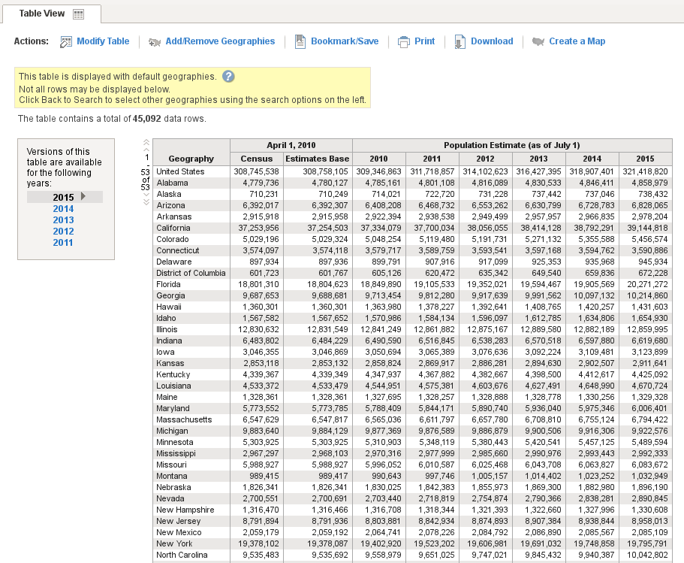
focus
I will focus on access mechanisms for researchers
Source: (Fox News/REUTERS/Kacper Pempel/Files/https://goo.gl/ZHMkog)
I will exclude
Newer mechanisms to create tabular data (synthetic data, differentially-private data)
I will include
Use of analytically-valid synthetic data as a access mechanism

Slide 16
context of my talk today
Focus on researcher access to authorized data collections
Not building new data collections, or enacting new laws
Focus on the mechanisms for providing access
Mostly physical
Access to microdata
Highlight the roles of “community”
Training
Legal framework
Role of institutions
Notes:
While the focus is not on building new data collections, the ability to protect existing data obviously has an impact on new data collections (see IMI,

Slide 17
some geographic limitation
Notes:
My experience has a certain Anglo-Saxon and European tint – I happen to have some experience and knowledge with the Brazilian case, but won’t reference that today.

Slide 18
history again

Slide 19
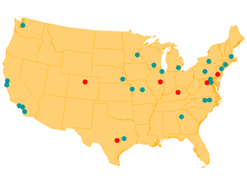
really brief history in the US
Starting in the 1960s and 70s, increased use of public-use microdata samples and surveys
Researcher access at Census Bureau headquarters in the 1970s
1990: [Computing power: 3.5 MFLOPS for $9000]
First RDC at Boston in the 1994
A small number of RDCs in the 1990s
Thin clients in the 2000s
2016: 24 RDCs
Notes:
… and so they keep knocking on the door

Slide 20
other countries: Germany
Institute for Employment Research (IAB), Germany
Commission to improve the informational infrastructure between the scientific community and official statistics
recommended creation of RDCs by producers of microdata (2001)
RDC created in 2004 for “weakly anonymous” data
Scientific use files (factually anonymous data) available under licensing agreements to university data enclaves
2011 RDC created at University of Michigan (with NSF funding)
(KVI)
1902
1942
1960
1985
today
2001
2004
2011
15 RDCs in 3 countries
Notes:
I‘m only going to focus on a few other countries that demonstrate some of the features I want to highlight
Kommission zur Verbesserung der informationellen Infrastruktur zwischen Wissenschaft und Statistik, KVI

Slide 21
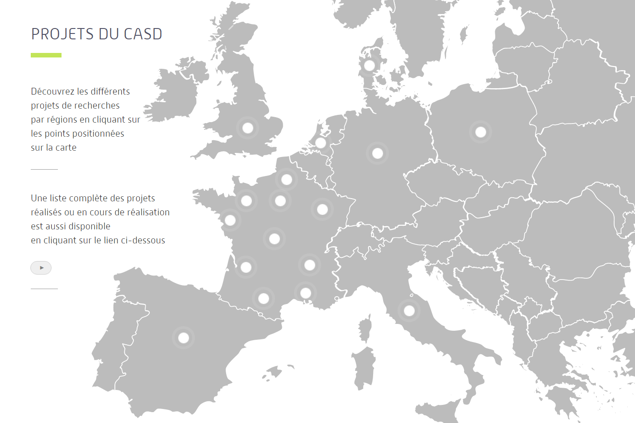
other countries: France
Centre d’accès securisé distant (CASD, France)
Note: within same agency that enabled AKM (1999)
INSEE recommended implementing a secure center for accessing data (2007)
2008 modification to Statistics Law made possible pilot infracstructure
Pilot infrastructure becomes permanent in 2009
Expansion with per-project cost (invoicing) in 2012
Loi Informatique et Libertés (1978)
1985
1995
2008
2012
today
1990
1st working group
2007
2009
371 APs in 8 countries
Source: presentation to the CASD Scientific Committee in 2013
Notes:
1990 census was a trigger, when increased demand hit stronger privacy protection – demographers and sociologists
CREST was the original privileged access holder to data, but a driver in making it a more public entity.

Slide 22
mechanisms

Slide 23
access methods
Tabulations
Tabulations
Public-use microdata
Raw microdata
Ease of access
Privacy loss →
← Loss of detail

Slide 24
access methods
Tabulations
Tabulations
Public-use microdata
Raw microdata
Ease of access
Privacy loss
Privacy loss →
← Loss of detail

Slide 25
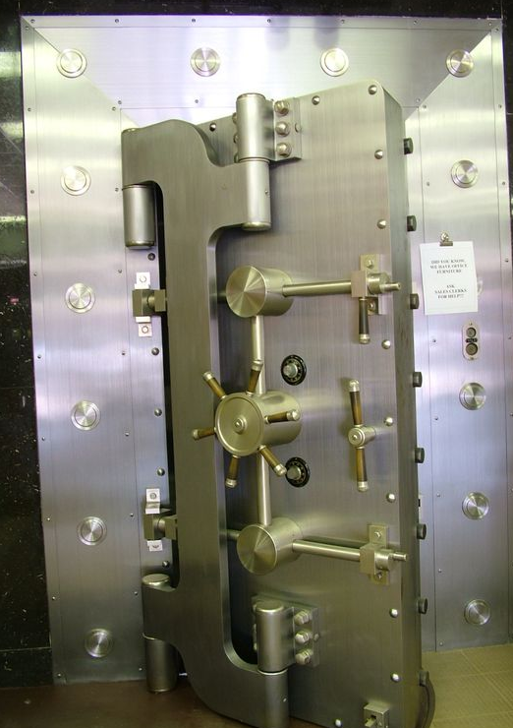
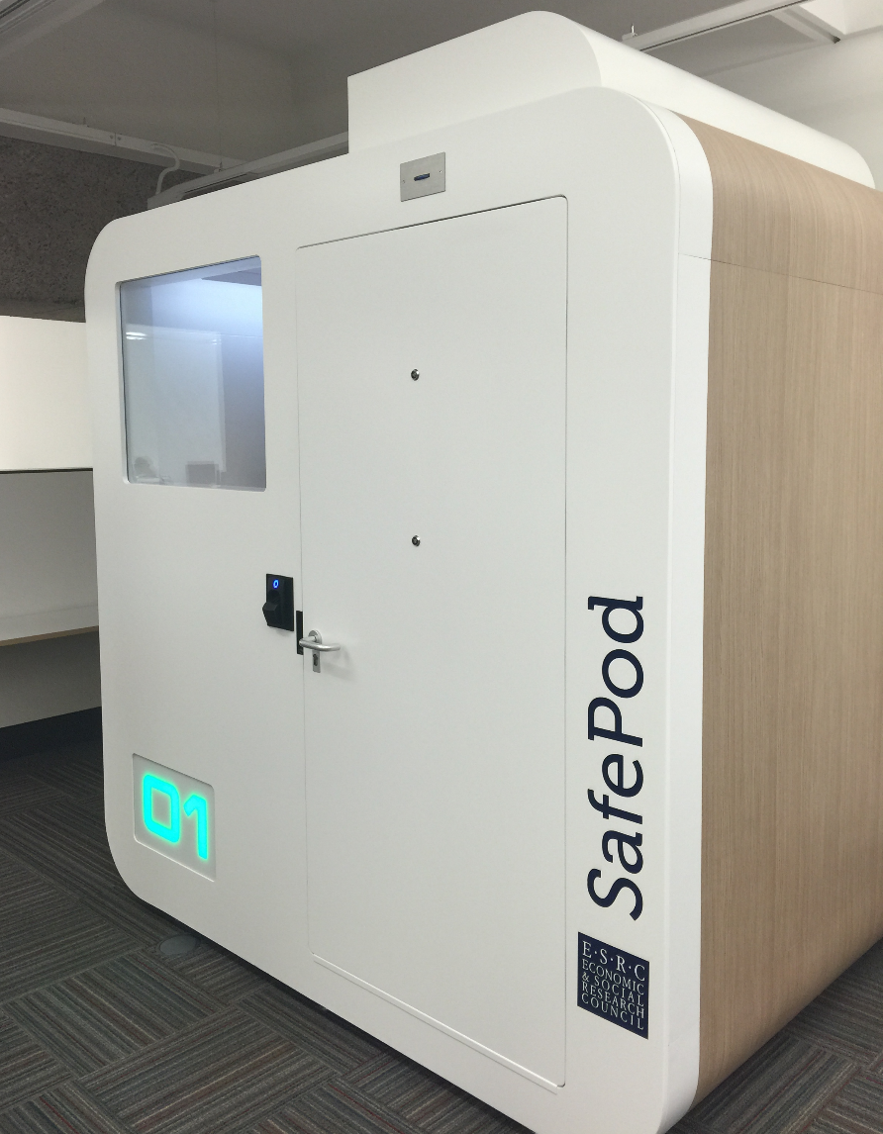
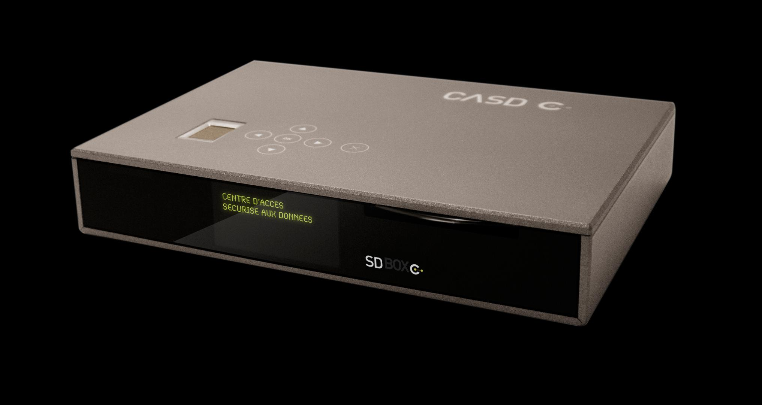
newer methods: Data Enclaves
custom tabulations (by staff) became too onerous
tabulation and analysis work offloaded onto researchers by providing them with access to protected microdata

Slide 26
access methods: enclaves
Tabulations
Tabulations
Public-use microdata
Software on your own PC giving a view onto secure data environment, with manual DA
Remote desktop
Ease of use
Thin client
Secondary secure PC giving a view onto secure data environment, with manual DA
Remote execution
Privacy loss
Submitting analysis programs by email or through website, with manual disclosure avoidance (DA) (possibly combined with synthetic microdata)
RDC
← Loss of detail

Slide 27
access methods: enclaves with researcher-controlled release
Tabulations
Tabulations
Public-use microdata
Self-controlled release
Raw microdata
Remote desktop
Ease of use
Thin client
Remote execution
RDC
← Loss of detail

Slide 28
access methods: enclaves with researcher-controlled release
Tabulations
Tabulations
Public-use microdata
Raw microdata
Remote desktop
Ease of use
Thin client
Self-controlled release
Remote execution
RDC
← Loss of detail

Slide 29

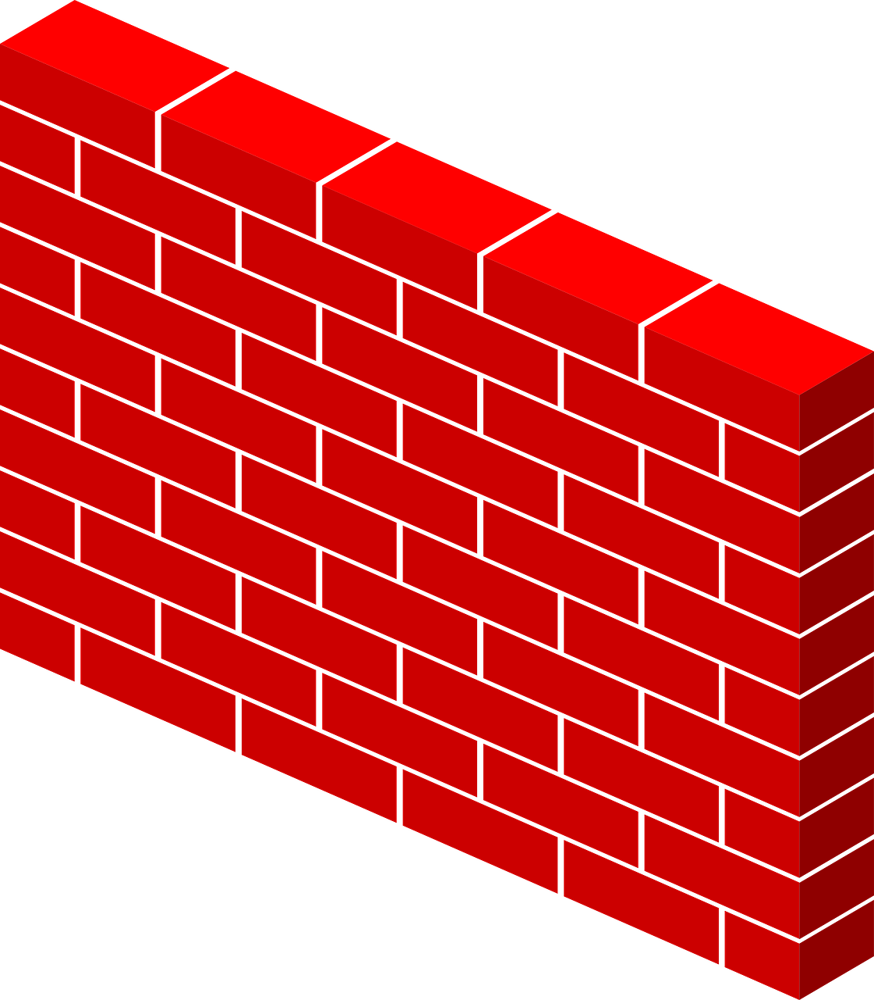

basic paradigm
What type of access device?
What type of room?

Slide 30
basic paradigm
What type of access device?
What type of room?

Slide 31

basic paradigm

Slide 32
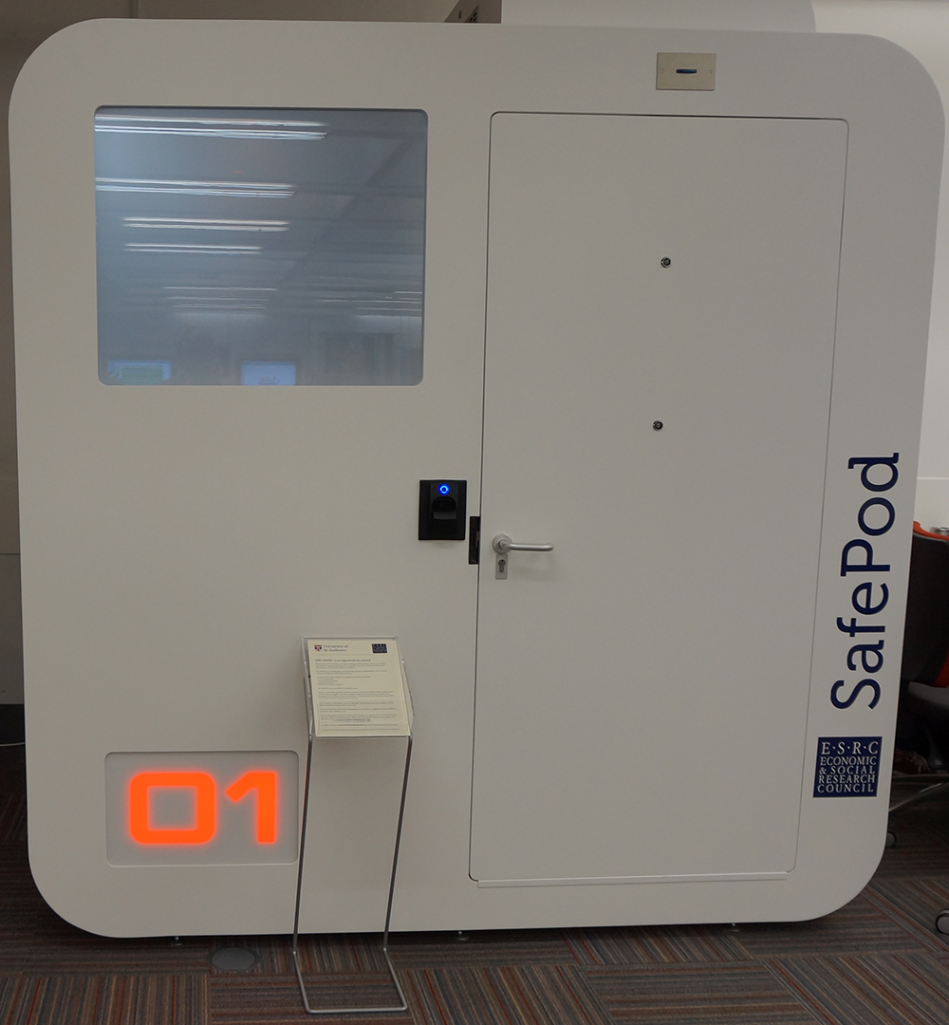
that spaceship thing…
Pre-fabricated secure room
First one installed in 2015 at University of St. Andrews (Scotland/UK)
2.3m x 1.8m
Electronic locking, biometric recognition, CCTV, “Smart Glass”
£ 25,000 ~ $30,000 incl. installation
Part of UK ADRN
[For now: EU]
(7’6” x 5’10”)
Source: http://libanswers.st-andrews.ac.uk/faq/93548

Slide 33
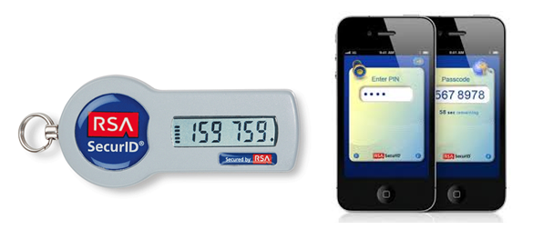


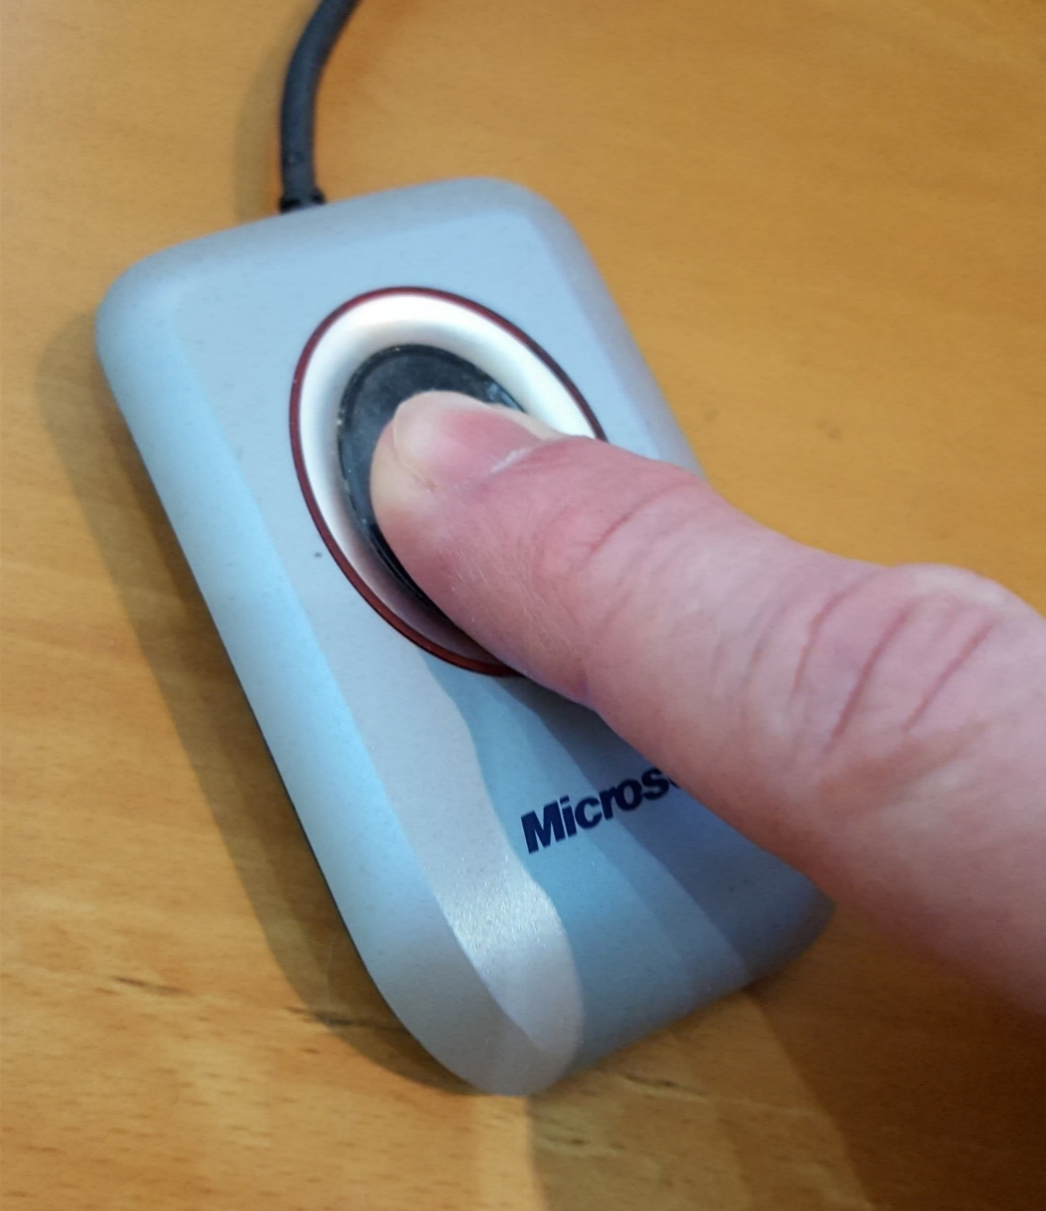
thin clients
With the notable exception of the Canadian RDCs (for now), thin clients are the preferred method of access
Surrounded by walls = RDC [FSRDC in US, Germany, others]
Embedded in a managed device = “thin client” [above, plus France]
Software with a managed access token = “remote desktop” or “VDI” [some US agencies; DK, Finland]
Additional controls may be
IP address control [many]
Biometric authentication [France]
Smart card [France, US]
70.48.127.42

Slide 34
that box thing
Custom remote access device used at CASD
Encrypted storage, biometric smartcard reader, pre-configured VPN
€35.00 / month, first user free, additional users €37.00 - €20.00 / month (decreasing)

Slide 35
scalability (CASD)
… added in 2016 alone
Totals
71 access points
232 users
62 projects
371 access points
1402 users
472 projects

Slide 36
lessons to be learned?
The very first RDCs were in North America (USA and Canada)
European systems came later
But can they provide new insights for our systems?

Slide 37
Access matrix for confidential data
Control of: | Data access | Analysis computers | Access computers | Access rooms | Analysis methods
FSRDC researcher | Full | Full | Full | Full (badge access) | Some (choice of software)
Census employee | Full | Full | None (VDI) | None (VDI) | Some (choice of software)
Control of: | Data access | Analysis computers | Access computers | Access rooms | Analysis methods
FSRDC researcher | Full | Full | Full | Full (badge access) | Some (choice of software)
Census employee | Full | Full | None (VDI) | None (VDI) | Some (choice of software)
IAB: RDC researcher | Full | Full | Full | Full (trusted person) | Some (choice of software)
IAB: JoSuA researcher | Full | Full | None (Web application) | None (Web application) | Smaller (software, whitelist commands)
Control of: | Data access | Analysis computers | Access computers | Access rooms | Analysis methods
FSRDC researcher | Full | Full | Full | Full (badge access) | Some (choice of software)
Census employee | Full | Full | None (VDI) | None (VDI) | Some (choice of software)
IAB: RDC researcher | Full | Full | Full | Full (trusted person) | Some (choice of software)
IAB: JoSuA researcher | Full | Full | None (Web application) | None (Web application) | Smaller (software, whitelist commands)
IAB employee | Full | Full | Full (IAB laptop) | None (VDI) | Some (choice of software)
Control of: | Data access | Analysis computers | Access computers | Access rooms | Analysis methods
FSRDC researcher | Full | Full | Full | Full (badge access) | Some (choice of software)
Census employee | Full | Full | None (VDI) | None (VDI) | Some (choice of software)
IAB: RDC researcher | Full | Full | Full | Full (trusted person) | Some (choice of software)
IAB: JoSuA researcher | Full | Full | None (Web application) | None (Web application) | Smaller (software, whitelist commands)
IAB employee | Full | Full | Full (IAB laptop) | None (VDI) | Some (choice of software)
CASD researcher | Full | Full | Extra Full (custom-built hardware) | Some (university office, EU) | Some (choice of software)
Control of: | Data access | Analysis computers | Access computers | Access rooms | Analysis methods

Slide 38
Access matrix for confidential data
Control of: | Data access | Analysis computers | Access computers | Access rooms | Analysis methods
FSRDC researcher | Full | Full | Full | Full (badge access) | Some (choice of software)
Stat.Denmark (typical EU) | Full | Full | None (VDI) - Some (host institution) | None (VDI) -Some (host institution) | Some (choice of software)
RDC Canada | Some (demog. only) | Some (host institution) | Some (host institution) | Full (badge access) | Some (choice of software)
Stat.Canada (typical of HQ) | Full (incl. business) | Full | Full | Full | Some (choice of software)
RDC Canada (thin client) | planned
Notes:
HQ also in Netherlands (drivable), replaced with Denmark-style VDI from university locations. HQ approach also in Brazil (Rio) – Instituto brasileiro da geografía e estatística. Canada: enclaves of StatCan within universities, owned and operated by universities, on university computers, under supervision and authorization of StatCan

Slide 39
Access matrix for confidential data
Control of: | Data access | Analysis computers | Access computers | Access rooms | Analysis methods
FSRDC researcher | Full | Full | Full | Full (badge access) | Some (choice of software)
Census employee | Full | Full | None (VDI) | None (VDI) | Some (choice of software)
IAB: JoSuA researcher | Full | Full | None (Web application) | None (Web application) | Smaller (software, whitelist commands)
CASD researcher | Full | Full | Extra Full (custom-built hardware) | Some (university office, EU) | Some (choice of software)
Stat.Denmark (typical EU) | Full | Full | None (VDI) - Some (host institution) | None (VDI) -Some (host institution) | Some (choice of software)
Notes:
Not worry about IAB RDC: lower threshold for rooms, but insubstantial (very similar to FSRDC). Remove the IAB employee (note also similarity to StatCan internal computers).

Slide 40
Access matrix for confidential data
Control of: | Data access | Access computers | Access rooms | Analysis methods
FSRDC researcher | Full | Full | Full (badge access) | Some (choice of software)
Census employee | Full | None (VDI) | None (VDI) | Some (choice of software)
IAB: JoSuA researcher | Full | None (Web application) | None (Web application) | Smaller (software, whitelist commands)
CASD researcher | Full | Extra Full (custom-built hardware) | Some (university office, EU) | Some (choice of software)
Stat.Denmark (typical EU) | Full | None (VDI) - Some (host institution) | None (VDI) -Some (host institution) | Some (choice of software)
Control of: | Data access | Access computers | Access rooms | Analysis methods | Disclosure avoidance
FSRDC researcher | Full | Full | Full (badge access) | Some (choice of software) | Manual/ variety of rules
Census employee | Full | None (VDI) | None (VDI) | Some (choice of software) | Manual/ self/ variety of rules
IAB: JoSuA researcher | Full | None (Web application) | None (Web application) | Smaller (software, whitelist commands) | Manual/ variety of rules
CASD researcher | Full | Extra Full (custom-built hardware) | Some (university office, EU) | Some (choice of software) | Manual/ variety of rules €300/ pack of 10
Stat.Denmark (typical EU) | Full | None (VDI) - Some (host institution) | None (VDI) -Some (host institution) | Some (choice of software) | Manual/ self/ variety of rules
Control of: | Data access | Analysis computers | Access computers | Access rooms | Analysis methods
FSRDC researcher | Full | Full | Full | Full (badge access) | Some (choice of software)
Census employee | Full | Full | None (VDI) | None (VDI) | Some (choice of software)
IAB: JoSuA researcher | Full | Full | None (Web application) | None (Web application) | Smaller (software, whitelist commands)
CASD researcher | Full | Full | Extra Full (custom-built hardware) | Some (university office, EU) | Some (choice of software)
Stat.Denmark (typical EU) | Full | Full | None (VDI) - Some (host institution) | None (VDI) -Some (host institution) | Some (choice of software)
Notes:
Not worry about IAB RDC: lower threshold for rooms, but insubstantial (very similar to FSRDC). Remove the IAB employee (note also similarity to StatCan internal computers).

Slide 41
access methods: remote tabulation
Tabulations
Tabulations
Remote tabulation
Public-use microdata
Raw microdata
Remote desktop
Ease of use
Thin client
Remote execution
RDC
← Loss of detail

Slide 42
access methods: remote tabulation
Tabulations
Tabulations
Public-use microdata
Raw microdata
Remote desktop
Ease of use
Thin client
Remote tabulation
Remote execution
RDC
← Loss of detail

Slide 43




remote processing paradigm

Slide 44
remote processing paradigm

Slide 45
Access matrix for remote submission
Control of: | Access computers | Access rules | Analysis methods | Disclosure avoidance | Cost
CB: Synthetic data | Custom compute cluster | Simplified proposal | Any (SAS, R Stata, Matlab) | Manual/ traditional | $0
IAB: JoSuA researcher | Web application | Full proposal | Smaller (Stata, whitelist commands) | Manual/ traditional | $0
Australian TableBuilder | Web application | Registration | Tables only | Embedded/ tab. noise infusion | $0/ >$0
Canada RTRA | Upload through Web | Simplified proposal + license | Smaller (SAS, whitelist commands) | Automated controlled rounding | $0
NCHS | Upload through FTP | Full proposal | Smaller (SAS, whitelist commands) | Manual/ traditional | $750/mth
Control of: | Access computers | Access rules | Analysis methods | Disclosure avoidance | Cost
CB: MAS/AQS | Web application | None (?) | Smallest (whitelist commands) | Embedded/ various | $0
Control of: | Access computers | Access rules | Analysis methods | Disclosure avoidance | Cost
CB: Synthetic data | Custom compute cluster | Simplified proposal | Any (SAS, R Stata, Matlab) | Manual/ traditional | $0
Notes:
Synthetic data is NOT a remote submission system, but it is a access mechanism

Slide 46
The ultimate remote submission
Co-author with an employee of stats agency…
Notes:
(this is a joke)

Slide 47
remote access setup
Some setup required
IAB’s JoSuA starts with a regular “on-site” access
NCHS has a regular proposal process, billing is involved
StatCan’s RTRA has a proposal process, review, etc.
Testing in order to process remotely
Dummy or test files (IAB)
“Synthetic” files (StatCan)
Pre-defined data dictionaries (NCHS)

Slide 48
synthetic data and remote submission
StatCan: “synthetic” data = univariate draws, no analytic validity
IAB also creates these types of files, but calls them “test” files
Census Bureau: “synthetic data” = analytically valid, conditional on congeniality of the model
Model is “verbally” described, but not formally

Slide 49
synthetic data: verification model
Under development (Reiter, Machanavajjhala)
Applied to OPM data
Researcher develops model on synthetic data
Assessment through submission of programs for “verification”
Researcher obtains (DP) indication of proximity to actual results
Restrictions on possible models (?)
Under development
Come back in April for NCRN workshop

Slide 50
synthetic data: validation model
Used for SIPP Synthetic Beta, Synthetic LBD
Researcher develops model on synthetic data
Assessment through submission of programs for “validation”
Researcher obtains actual results from model run on confidential data, subject to traditional disclosure avoidance rules
No restrictions on types of models
In progress since 2011
Approx. 200 users
Approx. 6-8% of users request validation
Some unknown fraction “self-validate” through full FSRDC project

Slide 51
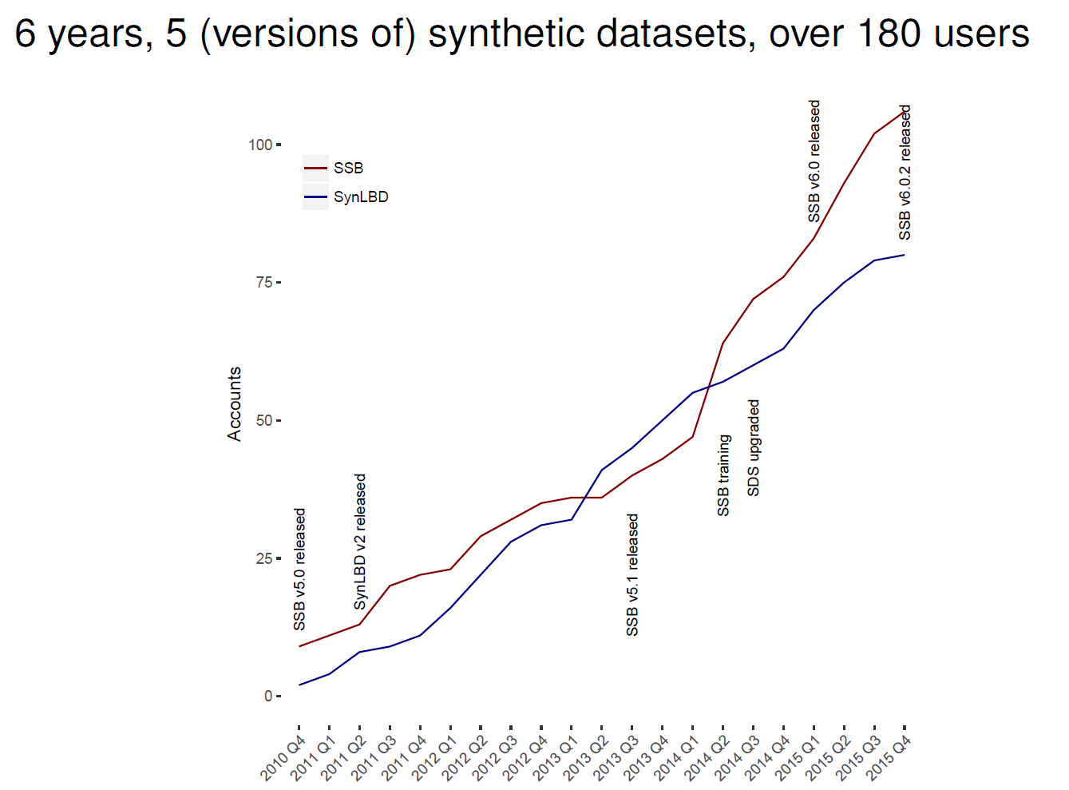
some results from Synthetic Data Server

Slide 52
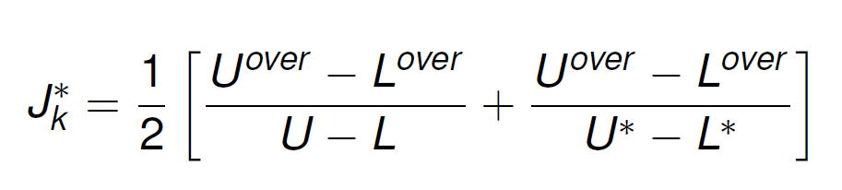
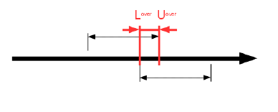
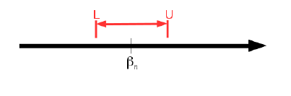
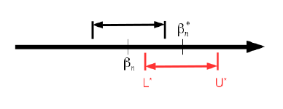
validation
About 6-8% request validation
Metric: confidence interval overlap J_{k} (Karr et al, 2006)

Slide 53
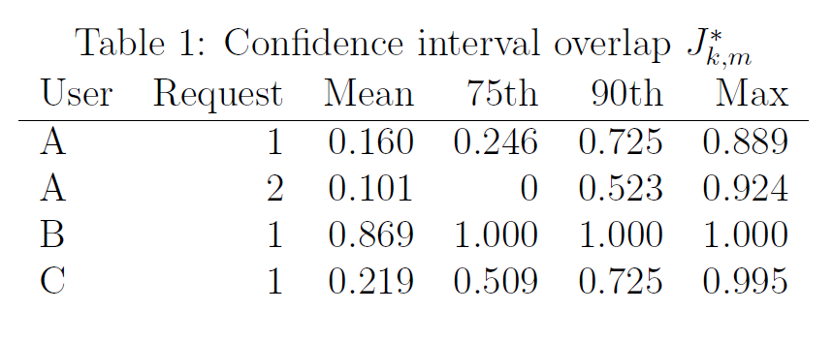
some results: SynLBD

Slide 54
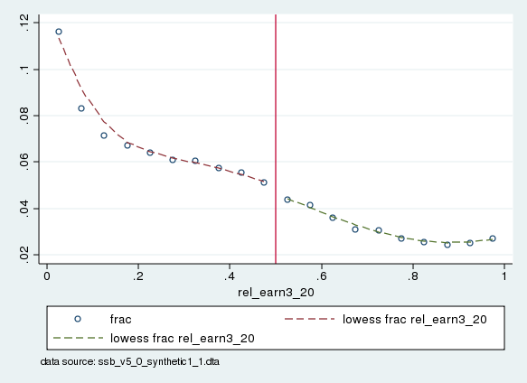
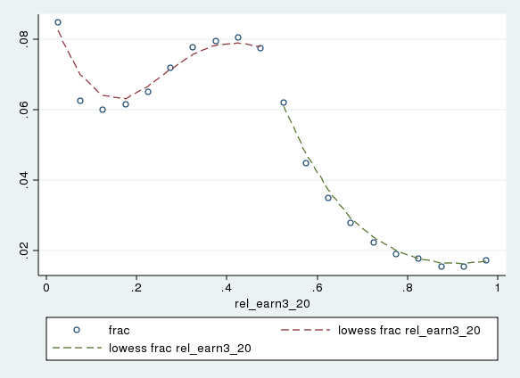
an illustrative example (Bertrand et al, 2015)
Notes:
Distinct break in the distribution of couples around 50% earnings ratio.

Slide 55
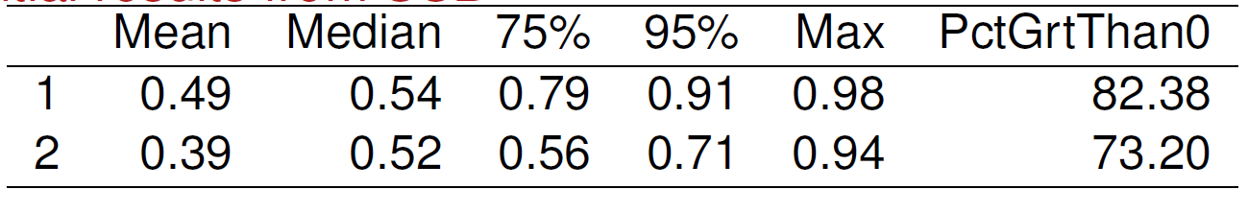
some results: SSB

Slide 56
synthetic data takeaways
Allow for modelling on the level of public-use data
More sophisticated than the usual remote submission system
Allow for faster validation on confidential data
Faster than RDC proposal process
Is limited in terms of analytic validity
But that may not be a bad thing
Can accelerate disclosure avoidance process
All tables that are to be released can be created beforehand
In theory…

Slide 57
Access matrix for confidential data
Control of: | Data access | Access computers | Access rooms | Analysis methods | Disclosure avoidance
FSRDC researcher | Full | Full | Full (badge access) | Some (choice of software) | Manual/ variety of rules
Census employee | Full | None (VDI) | None (VDI) | Some (choice of software) | Manual/ self/ variety of rules
IAB: JoSuA researcher | Full | None (Web application) | None (Web application) | Smaller (software, whitelist commands) | Manual/ variety of rules
CASD researcher | Full | Extra Full (custom-built hardware) | Some (university office, EU) | Some (choice of software) | Manual/ variety of rules €300/ pack of 10
Stat.Denmark (typical EU) | Full | None (VDI) - Some (host institution) | None (VDI) -Some (host institution) | Some (choice of software) | Manual/ self/ variety of rules
Notes:
So let’s go back to the access rules and disclosure avoidance mechanisms of the various systems.

Slide 58
Access matrix for confidential data
Control of: | Data access | Access computers | Access rooms | Analysis methods | Disclosure avoidance
FSRDC researcher | Full | Full | Full (badge access) | Some (choice of software) | Manual/ variety of rules
Census employee | Full | None (VDI) | None (VDI) | Some (choice of software) | Manual/ self/ variety of rules
IAB: JoSuA researcher | Full | None (Web application) | None (Web application) | Smaller (software, whitelist commands) | Manual/ variety of rules
CASD researcher | Full | Extra Full (custom-built hardware) | Some (university office, EU) | Some (choice of software) | Manual/ variety of rules €300/ pack of 10
Stat.Denmark (typical EU) | Full | None (VDI) - Some (host institution) | None (VDI) -Some (host institution) | Some (choice of software) | Manual/ self/ variety of rules
Notes:
How can the broad network of CASD terminals (spread out across 300+ locations), the quasi-employee type of access in the Danish system be maintained?

Slide 59
trust and access

Slide 60
trust and access
Frequent discussion
Security measures are for (malevolent) intruders/opponents
Researchers are trusted collaborators…
… who know what they are doing
A corollary:
Protect against the bad guys
But let the “good” guys do their thing
Examples:
Network-moderated access
Contracts with disclosure avoidance rules
How do you know who the good guys are?
Also known as the “old boys’ network”

Slide 61
theory: culture
Laws set the ground rules
The way penalties and contracts are set up are important
Researchers and agencies create the communities in which these rules are applied and enforced
Training and “indoctrination”
Common forums
More or less tight binding of researchers into the community

Slide 62
penalties

Slide 63
penalties
FSRDC and federal employee:
federal prison sentence of up to five (5) years, a fine of up to $250,000, or both.
France:
prison sentence of up to one (1) year, a fine of up to €15,000, or both.
IAB:
Loss of data access for up to two (2) years for researcher and institution
Contractual penalty up to €60,000 paid by the institution
Notes:
France – with the broadest network – has lower penalties (but still prison)
Germany (€60,000 ~ $67000 but increasing…) has no prison, and still relatively puny monetary penalties

Slide 64
penalties
Denmark:
Researcher: Loss of data access for life, or up to three (3) years for “minor breaches”
Institution: Loss of access for a positive but limited (undefined) period
No financial or penal penalties
Of Note: the FSRDC contract explicitly excludes a responsibility of the university for the actions of its employees.
Notes:
IAB and Denmark – binds the institution, not just the researcher

Slide 65
penalties
Note:
No system admits to ever having had to enforce the rules.
(rumors and videos notwithstanding)

Slide 66
(this slide was added after the presentation was given on Feb 9, 2017)
During my presentation, Simson Garfinkel (now Census Bureau) noted that Federal Wide Assurances (FWA) backstop the presence of FSRDCs on campuses, and that FWA have been withdrawn in the past.
I argued that the link between the FWA and the actual disclosure avoidance issues in the FSRDCs is tenuous, and not emphasized by universities at all (in my experience). I would put it into the same bin of “it’s a REALLY big stick, und unlikely to be wielded for minor infractions.” I also believe (my opinion) that the explicit exclusion of university responsibility in the FSRDC contract is meant to avoid the linkage between disclosure avoidance failures and the FWA.
I have heard that universities have been hesitant to sign the (more lenient, from a researcher perspective) German IAB RDC contract. This might be related to the more explicit link those contracts establish between university responsibility and researcher misconduct. But that is speculative.

Slide 67
training

Slide 68
hidden element: how is Disclosure Avoidance done?
Most access methods:
Enforcing minimum count of entities in a statistic (coefficient, mean, stddev)
Prohibiting creation of tabular data (or making it very expensive)
(Vain) attempt at tracking overlapping releases
Automated systems
Tracking of cells, implementation of (randomized) rounding, suppression, (output) noise infusion (StatCan, ABS)
Similar in CB’s Microdata Analysis System/Automated Query System
Newer mechanisms
Noise infusion upon computation
Differentially-private output perturbation (of model-based statistics, incl. coefficients and expected counts)

Slide 69
hidden cost: how to train the users?
Programming
DP-safe programming is hard for computer scientists → lost cause with social scientists until incorporated into SAS, Stata, etc.
Tools
Mostly lacking (in all of the environments that I have experienced)
Concept
Researchers have a hard time understanding confidentiality constraints
Researchers have a hard time accepting confidentiality constraints

Slide 70
results from a survey of FSRDC users
Survey run in October 2015, 145 respondents

Slide 71
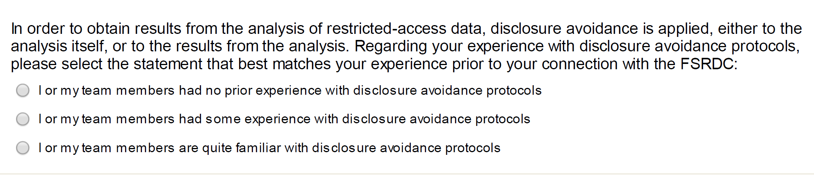
FSRDC user experience: DA protocols
39% no prior experience
30% some experience
31% quite familiar

Slide 72
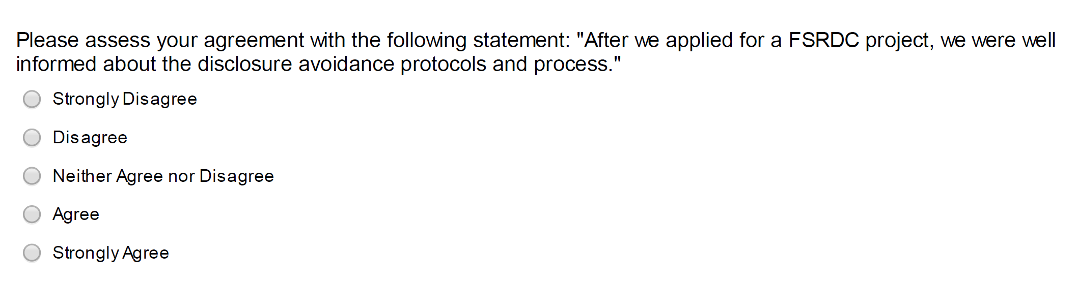
FSRDC user experience training
14% disagree or strongly disagree
73% agree or strongly agree
13% do neither

Slide 73
results from a survey of FSRDC users
Disclosure avoidance:
Users (NCHS) complained that “Disclosure avoidance personnel declined to approve output because they were not familiar with the software” despite pre-approval of generic output.
Other users grudgingly acknowledged that they “cannot avoid disclosure review” (on a NCHS project).

Slide 74
training content, method, and frequency
 | Frequency | Access rules? | Disclosure rules? | Disclosure avoidance tools? | Method
FSRDC | yearly | Initial | As needed | No | Online
IAB RDC | Initial | Initial | Yes | No | PDF (Contract, other)
CASD (France) | Initial | Initial | Yes | No | In person (3h)
Denmark | Initial | Yes | No | No | PDF (Contract)
Notes:
Initial + PDF means that no formal training occurs; rather, the information is transmitted through a contract or initial set of materials

Slide 75
Responsible Conduct of Research (RCR)
Course Introduction
Research Misconduct
Research Involving Human Subjects
Plagiarism
Authorship
Collaborative Research
Conflicts of Interest
Data Management
Mentoring
Peer Review
Approximately 3 hours
Note: No discussion of practical disclosure avoidance, etc.

Slide 76
French training
One-time initial training
3 (three) hours on-site classroom training
Travel to Paris required
First slide: legal penalties
Quarter of slides: disclosure rules
Mostly cell-count rules
Mostly (numeric) examples of primary/secondary suppression
Examples of what confidential supplementary files should look like
Half of slides: technical system with live demo

Slide 77
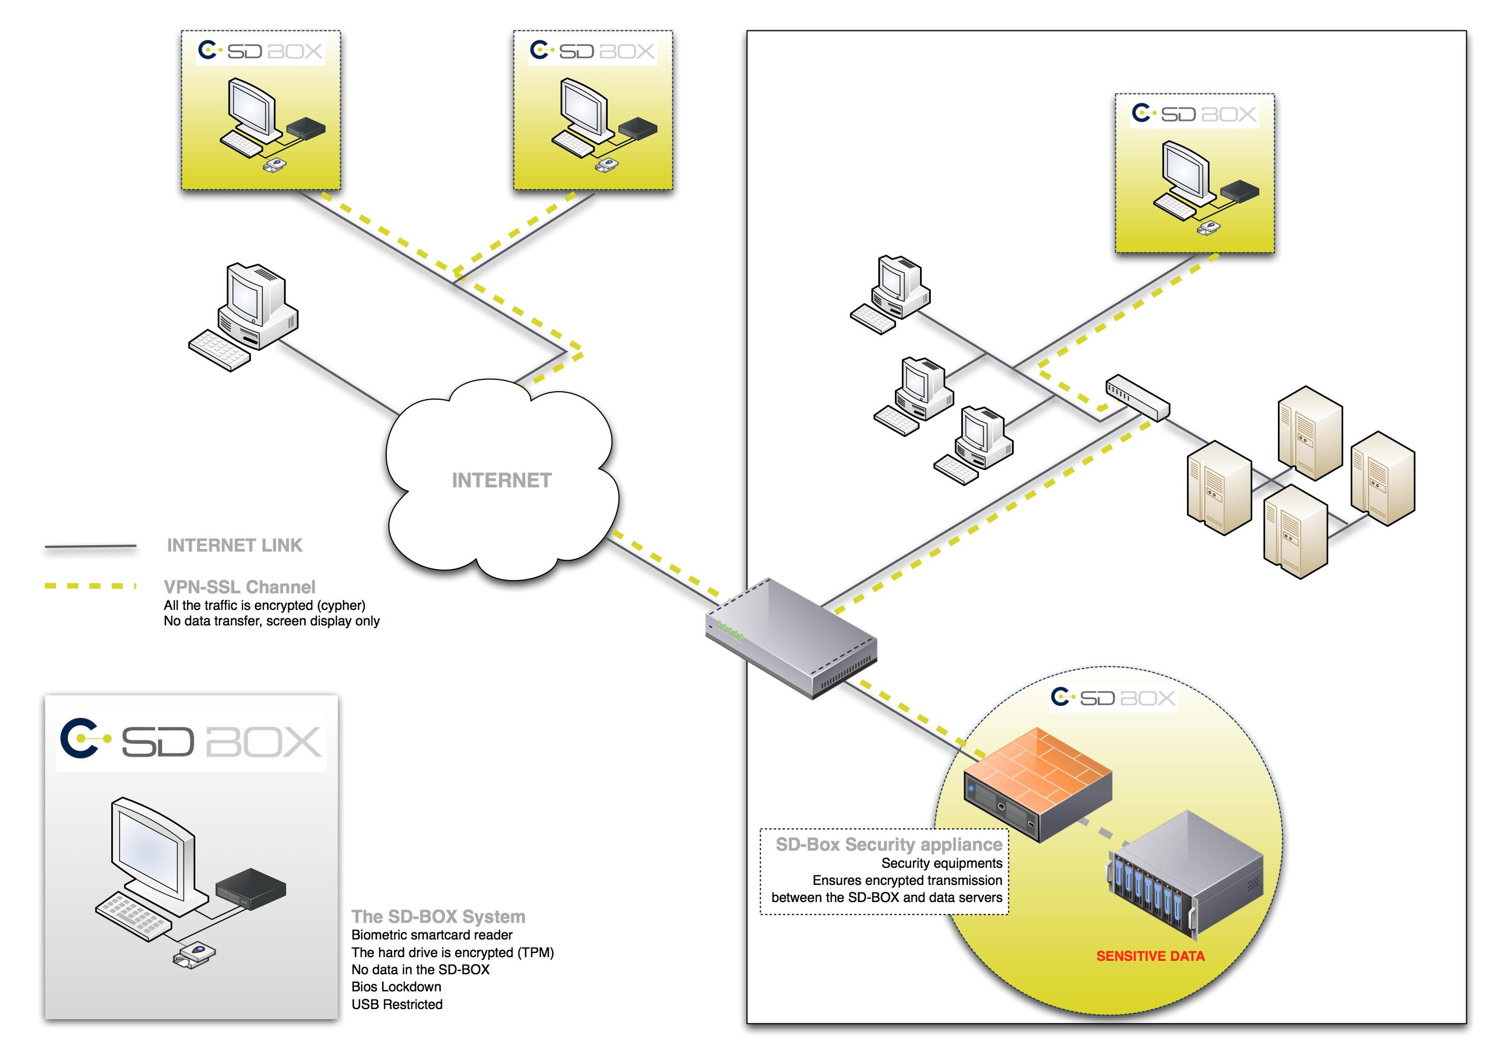
CASD setup
Source: CASD training materials 2017-01-12
Notes:
Researchers get shown the idea behind the infrastructure through this graph

Slide 78
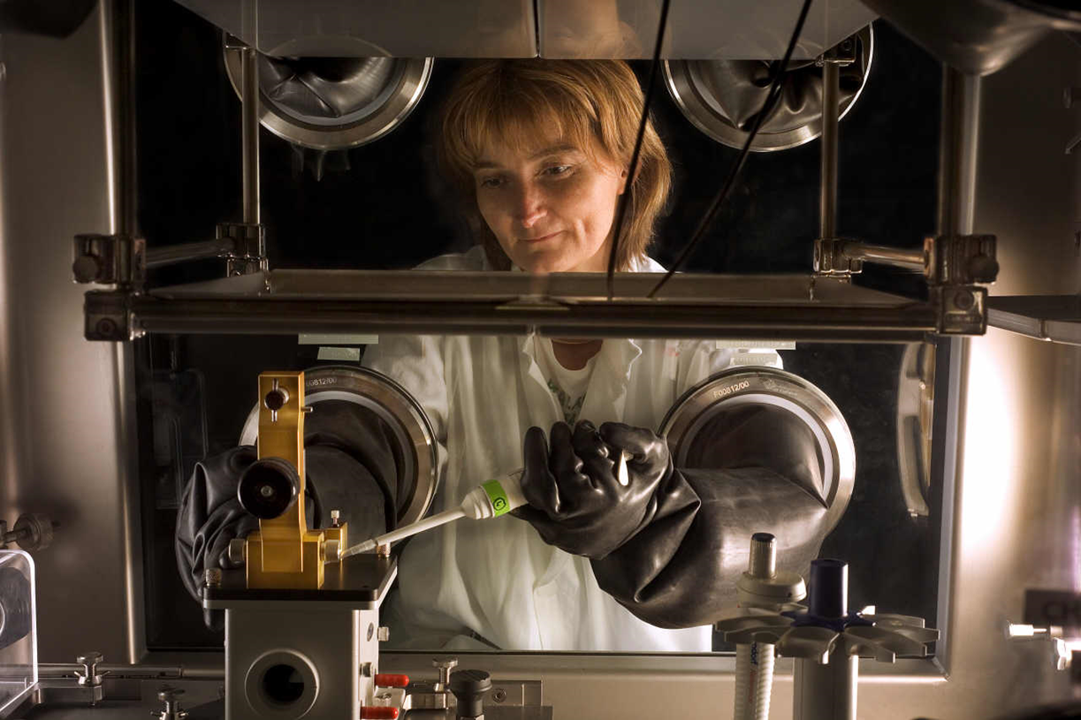
CASD setup
Source: CASD training materials 2017-01-12
Notes:
And are provided this picture of how they should consider the manipulation of data that they are performing.

Slide 79
CASD security
Four-factor authentication
Device
Card
Fingerprint
Password
Loss of card (+fingerprint data) → trip back to Paris to create a new one

Slide 80
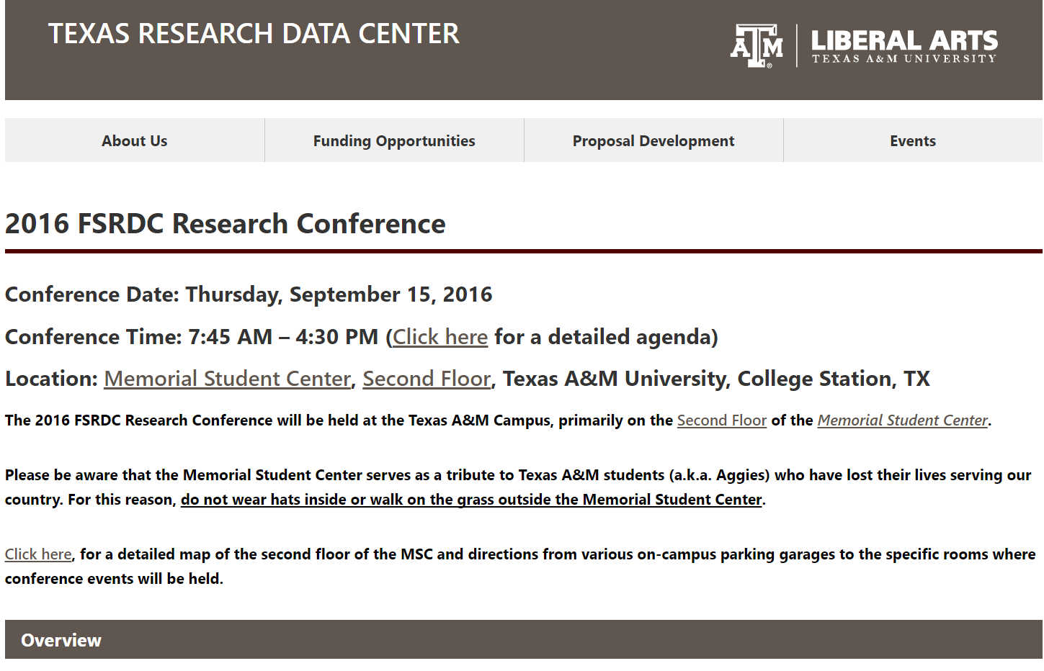
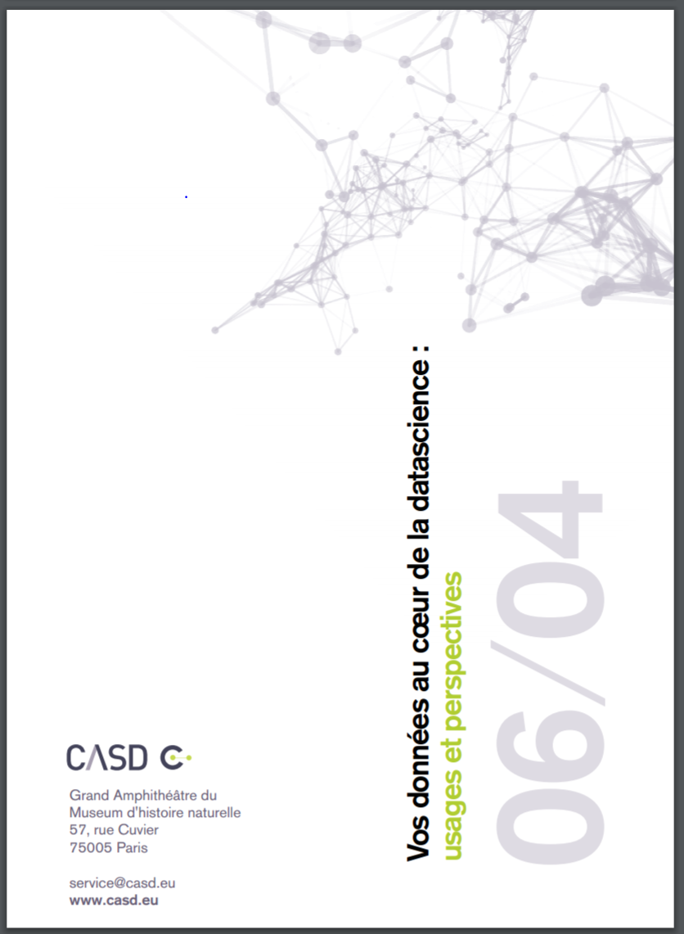
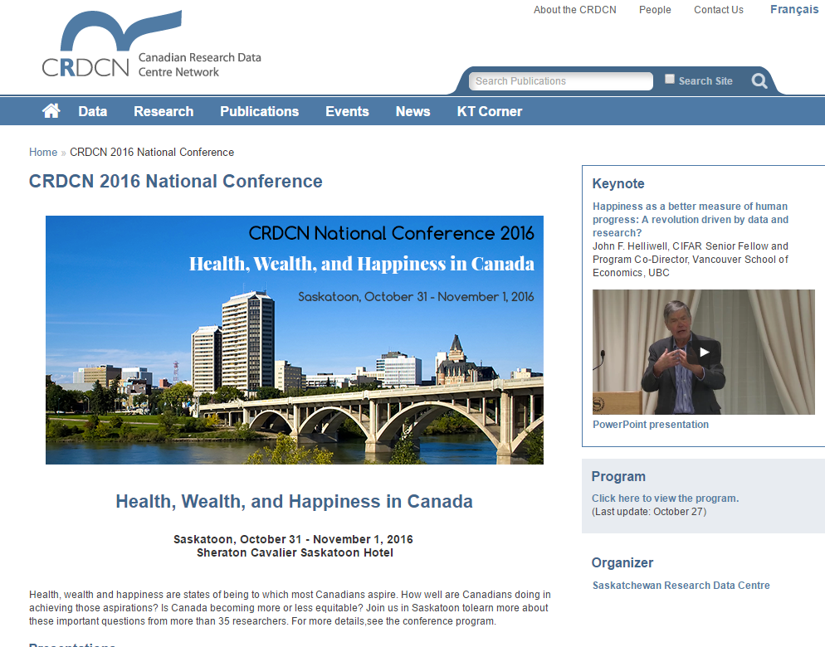
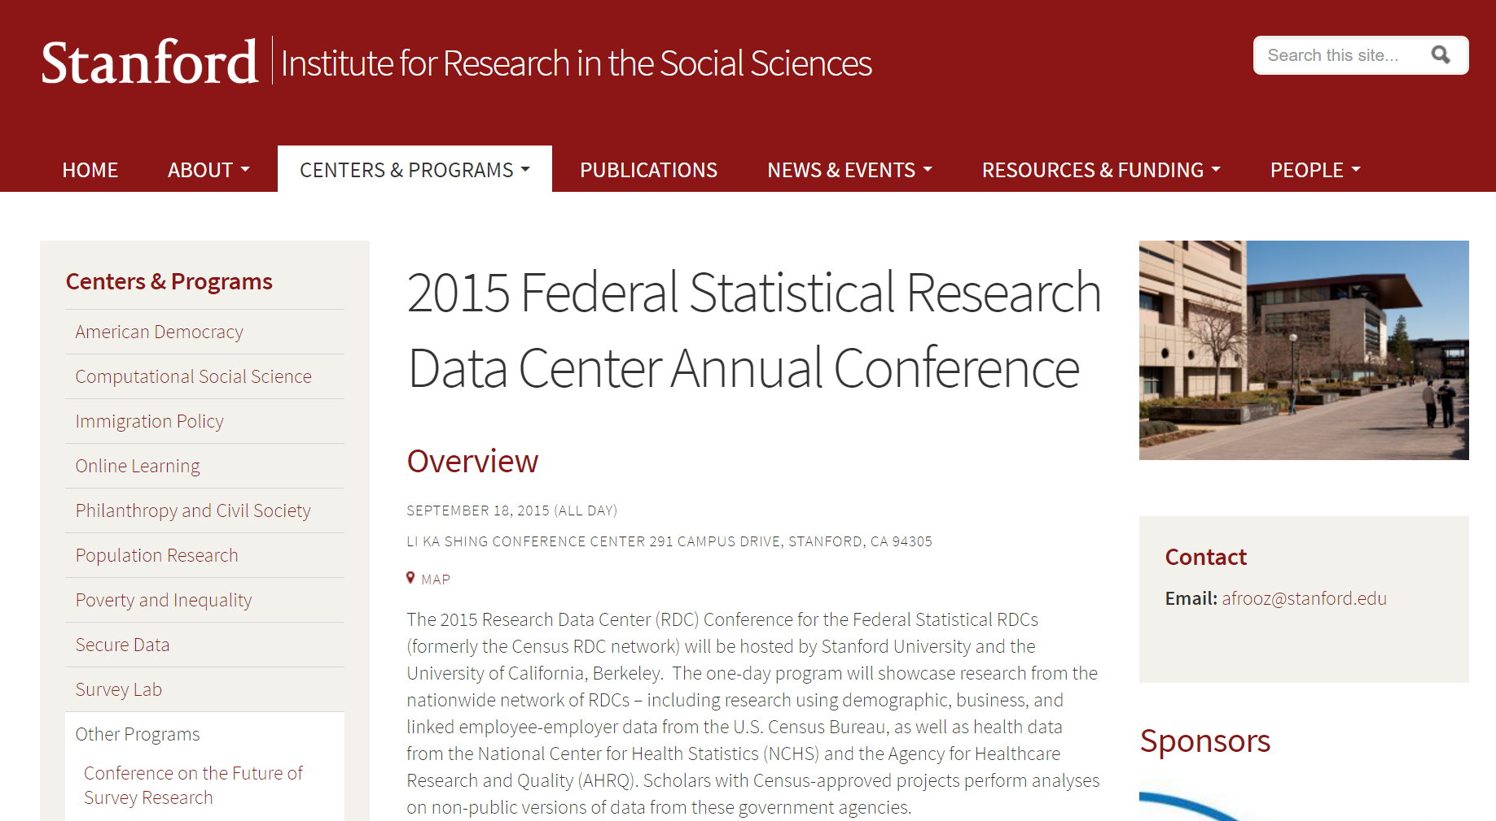
conferences
Notes:
Conferences are a key community-building tool, and the US and Canadian systems have long histories of holding such data-user oriented conferences (less so in Europe). [Image of Canadian RDC conference added after presentation]

Slide 81
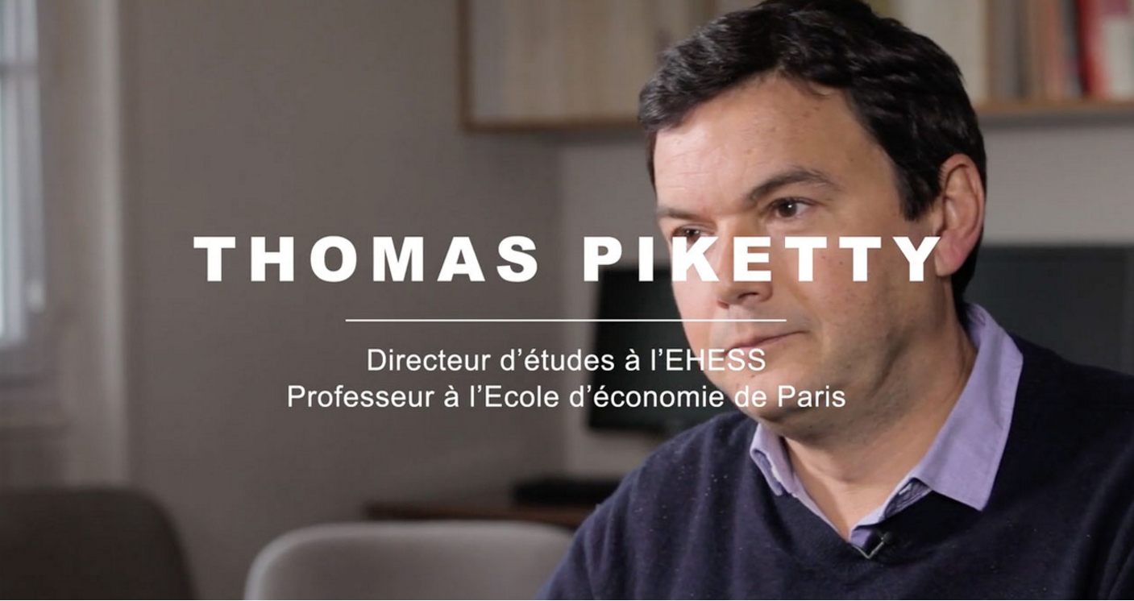
community
Census Bureau
CES seminars featuring FSRDC presenters
CES graduate mentorship
FSRDC conference
CASD
Initial training plays a role
So far, only one conference, but very high-profile
Piketty video [URL]
Minister of State for Digital Affairs Axelle Lemaire
Notes:
Axelle Lemaire (“minister of state” equivalent to undersecretary) – FSRDC has had the Under Secretary of Commerce for Economic Affairs (Mark Doms)

Slide 82
community (cont.)
IAB
(past) visits to Nürnberg suggested and funded to connect with researchers
So far, one international conference (at Michigan, organized by Maggie Levenstein)
Overseas RDCs are a community-building exercise
Flooding the job market with economics graduates who have worked with German data…

Slide 83
training content, method, and frequency
 | Frequency | Access rules? | Disclosure rules? | Disclosure avoidance tools? | Method
FSRDC | yearly | General (+ site specific) | General | No | Online
IAB RDC | Initial | No | Yes | No | PDF (Contract, other)
CASD (France) | Initial | Yes | Yes | No | In person (3h)
Denmark | Initial | Yes | No | No | PDF (Contract)
 | Frequency | Access rules? | Disclosure rules? | Method
FSRDC | yearly | General (+ site specific) | General | Online
IAB RDC | Initial | No | Yes | PDF (Contract, other)
CASD (France) | Initial | Yes | Yes | In person (3h)
Denmark | Initial | Yes | No | PDF (Contract)
 | Frequency | Access rules? | Disclosure rules? | Method | User conference
FSRDC | yearly | General (+ site specific) | General | Online | Yearly
IAB RDC | Initial | No | Yes | PDF (Contract, other) | Irregular
CASD (France) | Initial | Yes | Yes | In person (3h) | 2016
Denmark | Initial | Yes | No | PDF (Contract) | ?
Notes:
Initial + PDF means that no formal training occurs; rather, the information is transmitted through a contract or initial set of materials

Slide 84
summary

Slide 85
summary
Remote access of some type is the standard practice around the world
Access locations and ease of releasing results vary substantially
Disclosure avoidance process is still quite pedestrian in almost all cases, and DA methods are “old-fashioned”
Remote submission methods remain quite limiting
Newer access mechanisms (synthetic data) successfully combine ability to estimate arbitrary models with robust (provable) protection mechanisms, but remain at an early stage

Slide 86
access and trust
Legal obligations matter
Criminal vs. contractual obligations
Obligating the institutions more strongly may help relax other constraints
Community matters
Pulling researchers close to the statistical agency through training
Creating a community through conferences, mentoring, etc.

Slide 87
the ultimate achievement
What kind of community, training, legal environment would the FedStat system need to implement to allow researches to access confidential data the same way Census employees do?

Slide 88

thank you
lars.vilhuber@cornell.edu

Slide 89

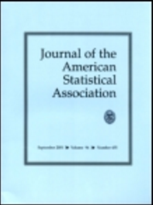
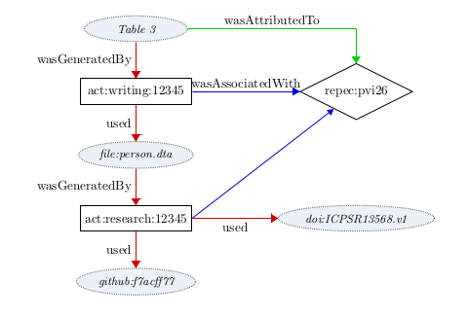
p.s. one last thing
Replicability is a nascent problem
More and more journals require provable replicability
Cannot be satisfied with idiosyncratic access mechanisms
Some research with confidential files will lose (reputable) publication outlets
Transparency critical
Need capability to be able to archive research files within secure enclaves
Need ability to publically identify such files (documentation) [DDI, DOI]

Slide 90
thank you
lars.vilhuber@cornell.edu

Slide 91
Thanks
Stefan Bender (formerly IAB and now Bundesbank, Germany)
Jörg Heining (IAB, Germany)
Roxanne Silberman (CASD, France)
Kamel Gadouche (CASD, France)
Jean Poirier (CIQSS, Canada)

Slide 92
Some References
Walter Wilcox (1914) cited in Anderson, Margo J., and Seltzer, William. “Federal Statistical Confidentiality and Business Data: Twentieth Century Challenges and Continuing Issues’.” Journal of Privacy and Confidentiality 1.1 (2009): 7-52, 55-58.
Kohlmann, Annette (2005): “The Research Data Centre of the Federal Employment Service in the Institute for Employment Research.” In: Schmollers Jahrbuch 125, 437-447
Allmendinger, Jutta and Kohlmann, Annette (2005) “Datenverfügbarkeit und Datenzugang am Forschungsdatenzentrum der Bundesagentur für Arbeit im Institut für Arbeitsmarkt- und Berufsforschung”. In: Allgemeines Statistisches Archiv 89, S. 159-182
Heining, Jörg (2010): “The Research Data Centre of the German Federal Employment Agency: data supply and demand between 2004 and 2009.” In: Zeitschrift für ArbeitsmarktForschung, Jg. 42, H. 4, S. 337-350. http://www.iab.de/389/section.aspx/Publikation/k100128n09
Kargus, Andrea; Müller, Anne (2014): “Auch in Nürnberg möglich: Von der zweiten Liga in die Champions League - ein Gespräch mit Stefan Bender.” In: IAB-Forum, Nr. 2, S. 38-45. http://www.iab.de/188/section.aspx/Publikation/k141201301
Kraus, Rebecca S. (2011): “Statistical Déjà Vu: The National Data Center Proposal of 1965 and Its Descendants.” Presentation at JSM 2011. https://www.census.gov/history/pdf/kraus-natdatacenter.pdf

